Slide 1
The Declarative paradigm shift
Imperative approach
Activity
XML

Slide 2
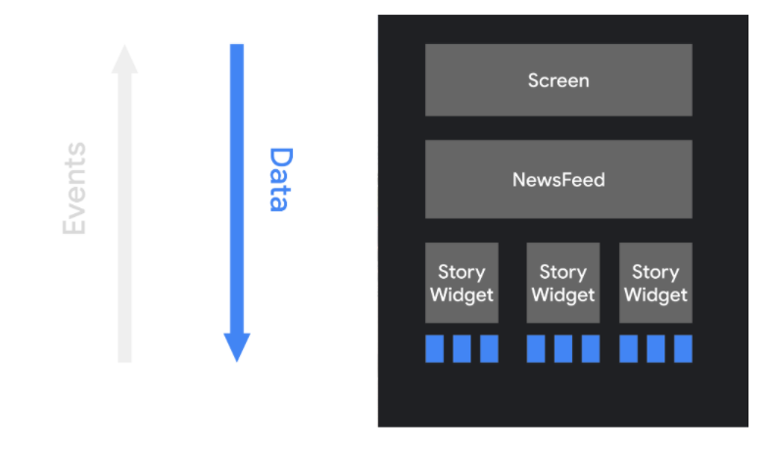
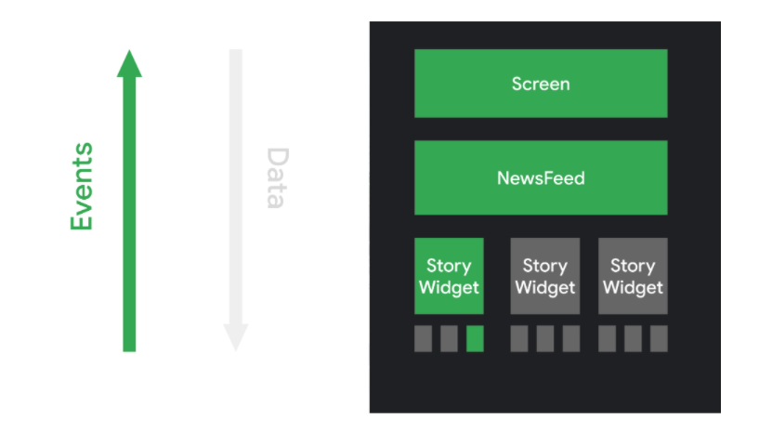
The Declarative paradigm shift
Declarative approach

